Slide 1
Executive Secretariat SWIFT FY21 Enhancements (Server Implementation) March 23, 2021
Enterprise Architecture
OCIO Policy, Strategy and Planning (PSP) division
Shamila beslow (Business Partner)

Slide 2
Overview
SWIFT is a Case management system used to manage executive correspondence for ACF and other tenant agencies
ACF partners with other mid-size OpDivs and some StaffDivs share costs by utilizing a single installation of SWIFT located in a PSC data center in Reston, VA maintained by Sev1Tech.
SWIFT was developed using multiple technologies from Microsoft, Adobe, Infragistics, and Data Dynamics. The system utilizes MS .Net framework with SQL Server backend and interfaces with Salesforce in the Office of the Secretary to seamlessly transfer cases between the Secretary and the ACF.
SWIFT servers upgraded to Windows Server 2016 and SQL Server Enterprise 2016 in 2019.
Sole Solutions Inc (SSI has developed and maintains the SWIFT application
There are three installations of SWIFT across HHS: CMS - Baltimore, HRSA - Rockville, and ACF, SAMHSA, Assistant Secretary for Planning and Evaluation (ASPE), Assistant Secretary for Preparedness and Response (ASPR), and Office of Assistant Secretary of Health (OASH) - Reston
SWIFT is Government Off-the-Shelf (GOTS), a method to enable reuse of software across multiple projects.

Slide 3
SWIFT FY21 Enhancements (Server Implementation) Business Requirements
Reporting Platform Enhancements and Dashboard Design
Provide program office with more stats on performance and workload metrics
Ability to decompose, or drill down, into the performance and workload of individual groups and divisions
Integrate existing Wyn Enterprise Dashboard reporting platform with SWIFT to provide SSO
Automate filtering of SWIFT role
SWIFT Validation (Test) Environment
Add a validation (test) environment to the current hosting platform to test changes due to HHS infrastructure or security as well as application
Work with OTIO to implement, test, install and configure the SWIFT application software on two virtual servers: an application/task server and a database server.
Other Enhancements
Hide late responses from previous assignments
Display package forwarding information
Expand the list of approval packages displayed to cover the past year
Schedule a formal Technology Refresh release to maintain capability with ACF desktop configurations. This will include the latest version of Internet Explorer or other browser, Microsoft Office and Windows.
Develop an Annual Technology Refresh plan

Slide 4
To-Be Validation (Test) Environment – Areas to Clarify
Is the validation (test) environment software architecture similar to the current system?
What type of information is redacted before transferring it to the test environment?
Who will have access to the new validation environment?
What type of user authentication is implemented today?
Can technical details be provided on how Wyn Enterprise Dashboard reporting platform will be integrated with SWIFT and how that will enable SSO capability and automatic filtering by SWIFT role?
Based on the business requirements, the validation environment will be used for testing HHS infrastructure or security changes. Could you provides an example of those changes and what tests will be performed?

Slide 5
Backup

Slide 6
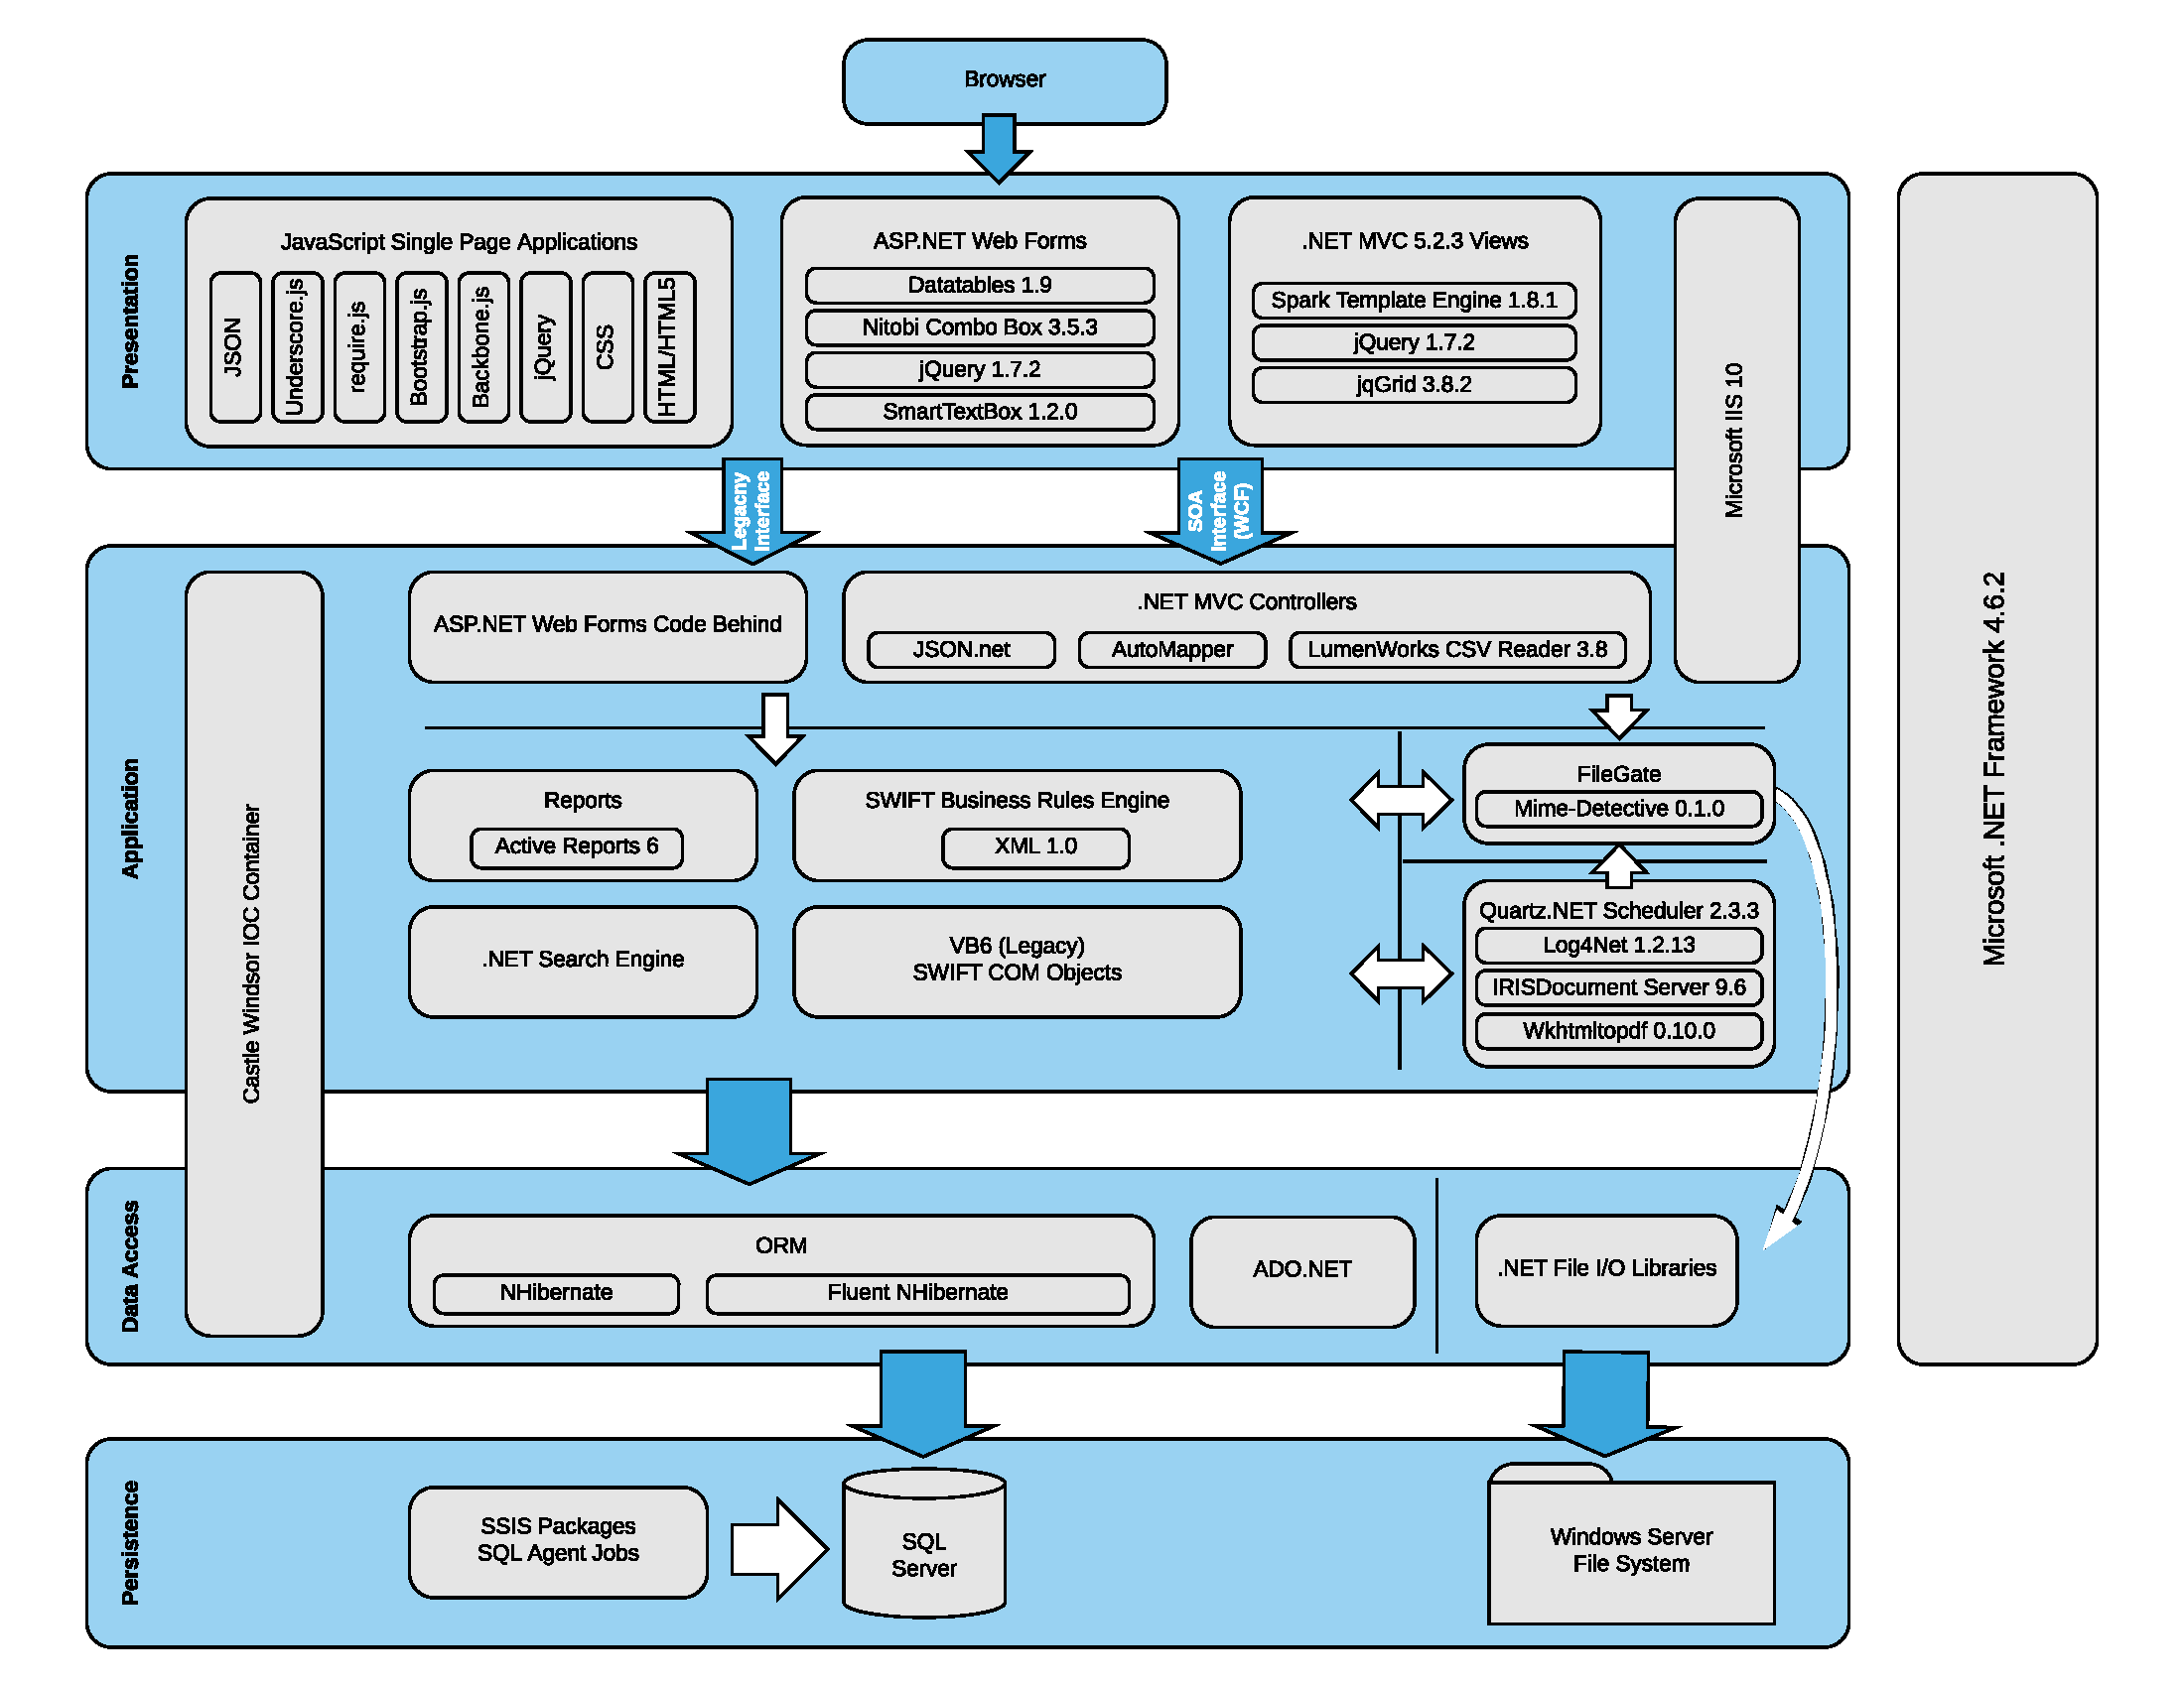
SWIFT Software Architecture

Slide 7
References
Wyn Enterprise Dashboard
https://wyn.grapecity.com/docs/user-guide/Document-Portal-for-End-Users/Create-Dashboard
SWIFT_Server_Upgrade_Design_Doc_Final.docx
ExecSec_SWIFT FY21 Enhancements_server_implementation.docx

